Slide 1


Presented By:
Hamza Khan
(FA19-BCE-075)
Inamullah Khan
(FA19-BCE-083)

Slide 2


Arduino Based Remote Door Lock/Unlock Mechanism
Lock/Unlock system via remote
Physical/Wire-lessly Control Door
Linked with Internet of things(IoT)

Slide 3
Why this System?
elderly, blind or handicapped people faces problem with traditional door.
Lazy People
Heading Toward Internet of things(IOT)
Simple button press

Slide 4
Methodology
V- model
Requirements begin the life cycle
Before development is started, a system plan
High-level design (HLD) phase focuses on system architecture and design
Low-level design (LLD) phase is where the actual components are designed.
minimize the development time by having predefined expectations

Slide 5
Requirements Phase
lock/Unlock the door with the help of remote.
One button for locking , another for unlocking.
Motor will move clockwise for locking and counterclockwise for unlocking.
Each remote buttons will have different codes.
No 2 doors will be unlocked with same button.
The locking unit and Electronic unit should be separate modules
Person Should be in range.

Slide 6
Hardware Specifications
Main Controller
Atmega328
Sensor System
IR Receiver
Motion Control
Servo Motor

Slide 7
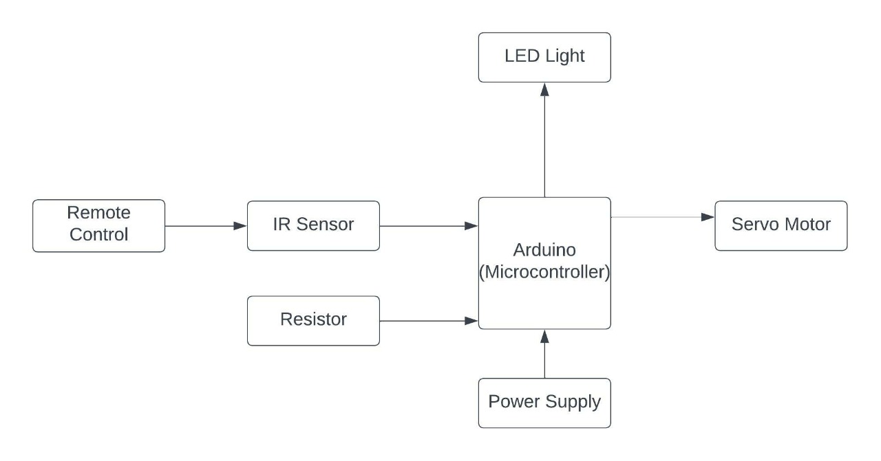
Model
Fig: Block Diagram

Slide 8
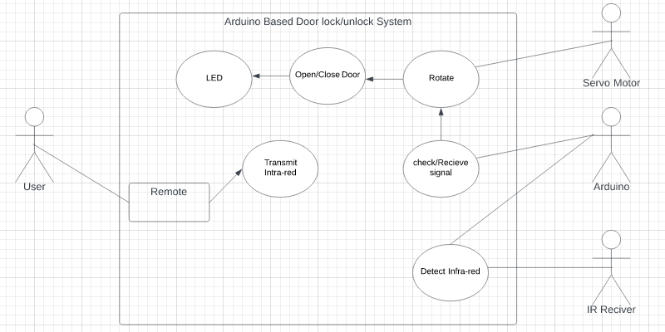
Cont.
Fig: Use Case Diagram

Slide 9
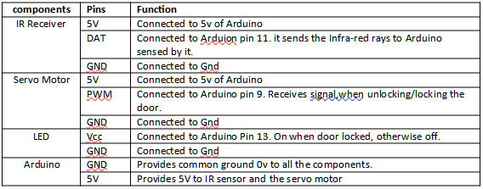
Pins Configuration

Slide 10
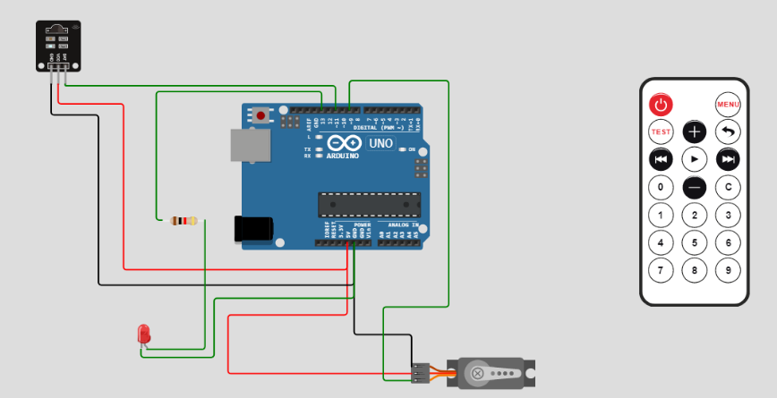
Implementation
Fig: Circuit

Slide 11
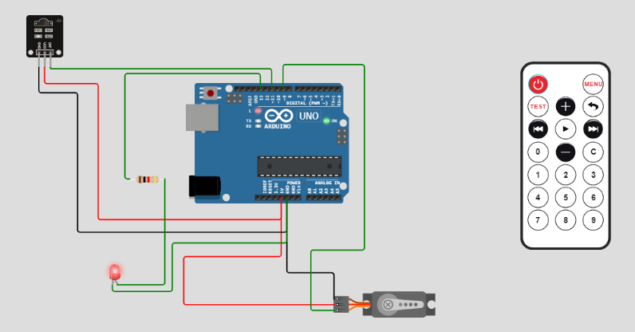
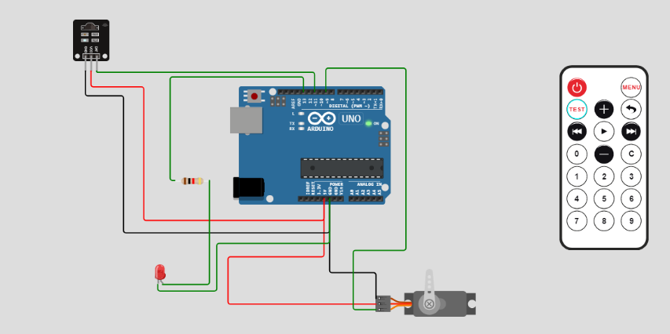
Testing
Case : Door Close
Case : Door Open

Slide 12
Testing
Testing Case 1: Normal Open/Close-ing Door
Objective: Ensure porper lock/unlock-ing door.
Testing Case 2:Pressing both button Simultaneously
Objective: Ensure door work correctly with simultaneous clicking of button.

Slide 13
Conclusion
IR sensor based Electronic door locks systems using Arduino.
This helps the disabled or elderly people in locking/unlocking the door.
helps control the door lock from anywhere(in range) using a remote control.
Replacing the remote-controlled system with the concept of Internet of Things (IoT).
home automation.
a good future for this prototype.

